Slide 1
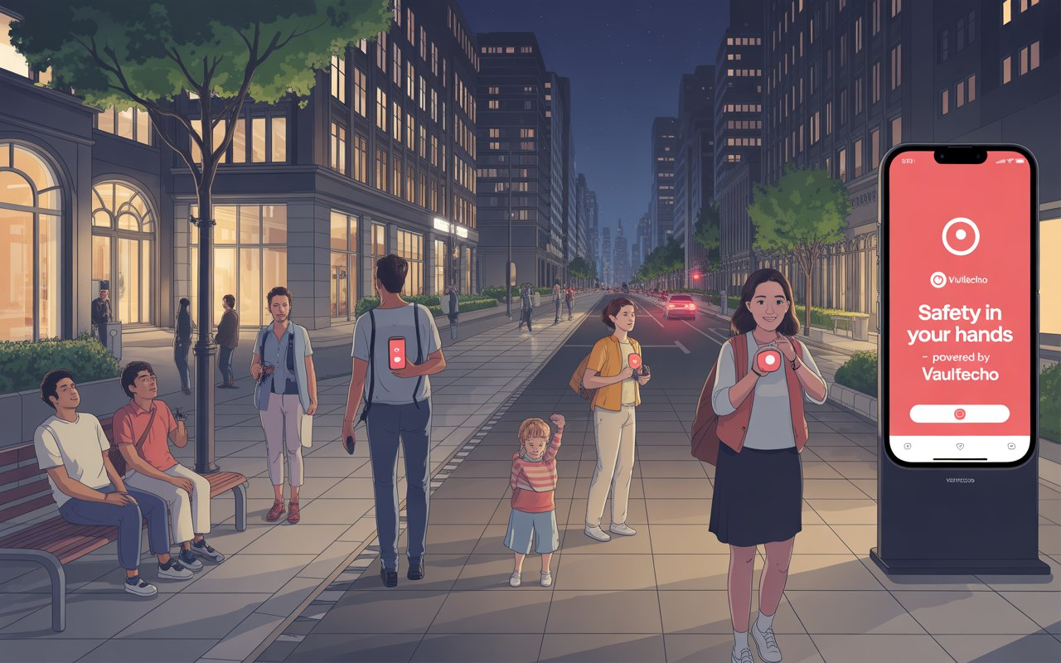


Vaultecho
Turning Silence into Signal
The Minds Behinds Vaultecho:
Pariwash Khan
Ammar Ahmed Khan

Slide 2


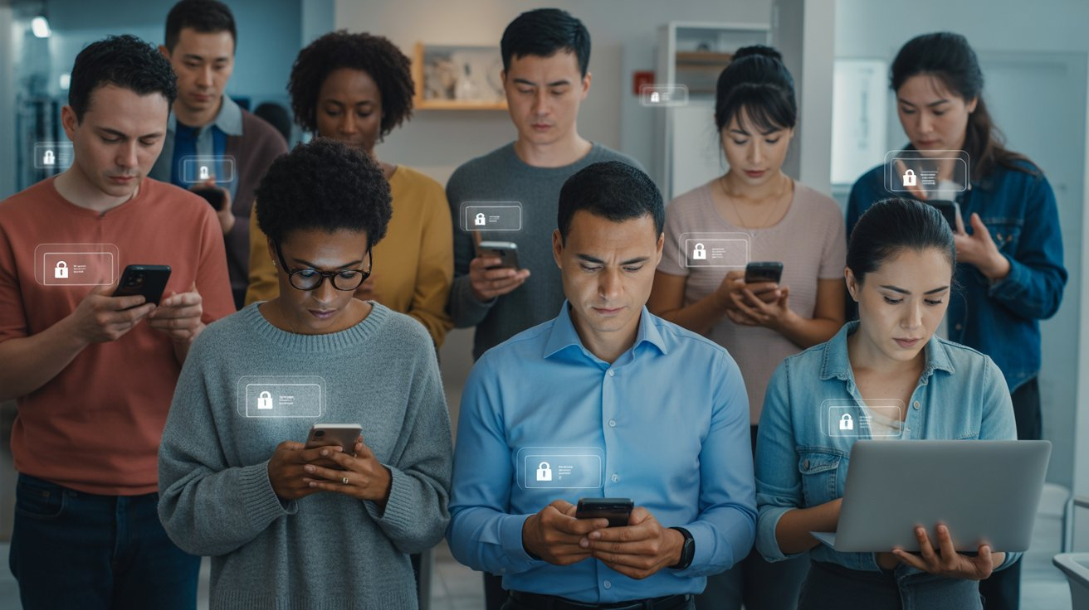

What is Vaultecho?
Vault: Safety Echo: Awareness
Raise Awareness
Educating users on potential dangers and protective safety measures.
Teach the youth safety
today, so they can protect
lives tomorrow.

Slide 3
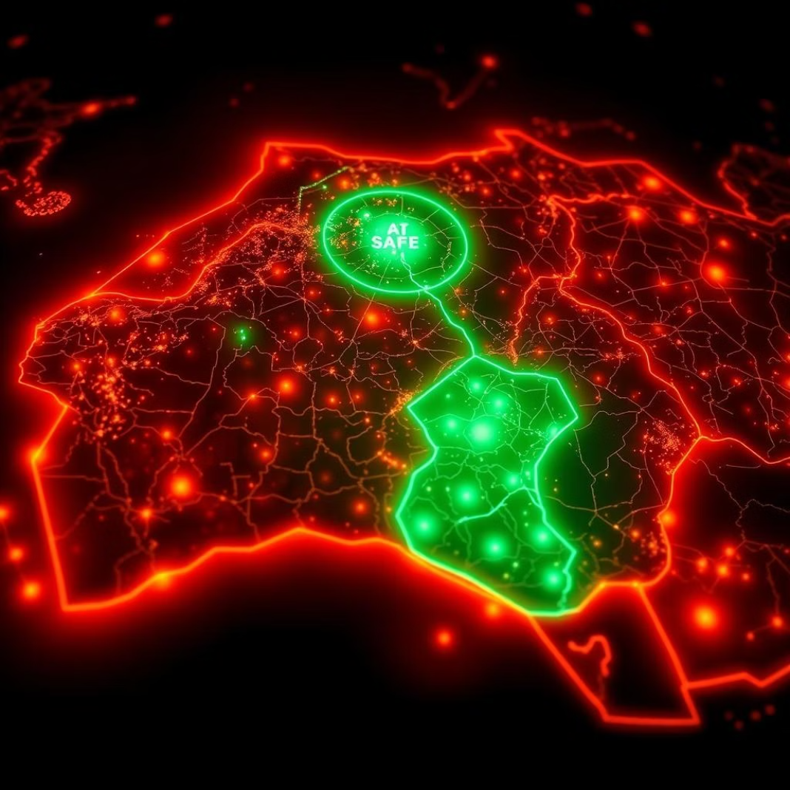
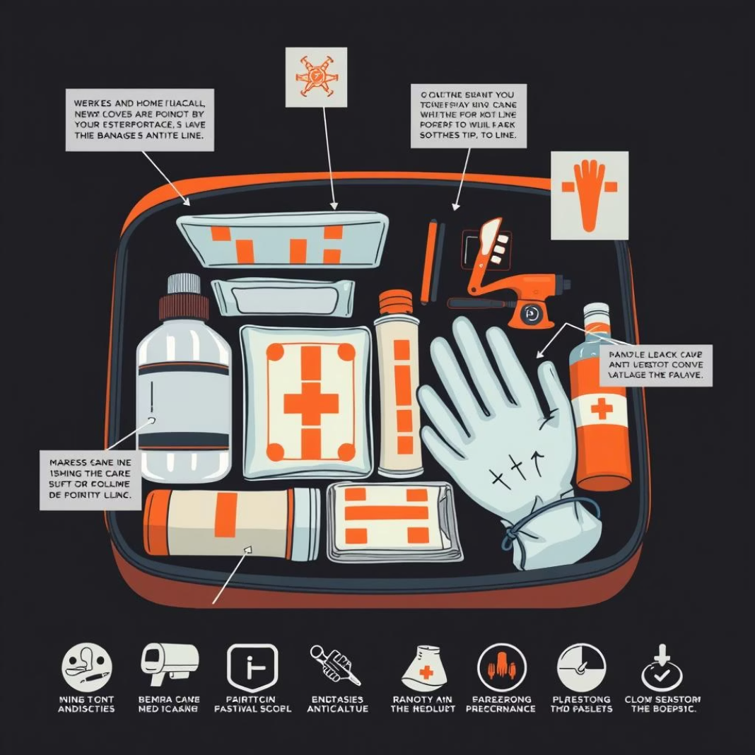
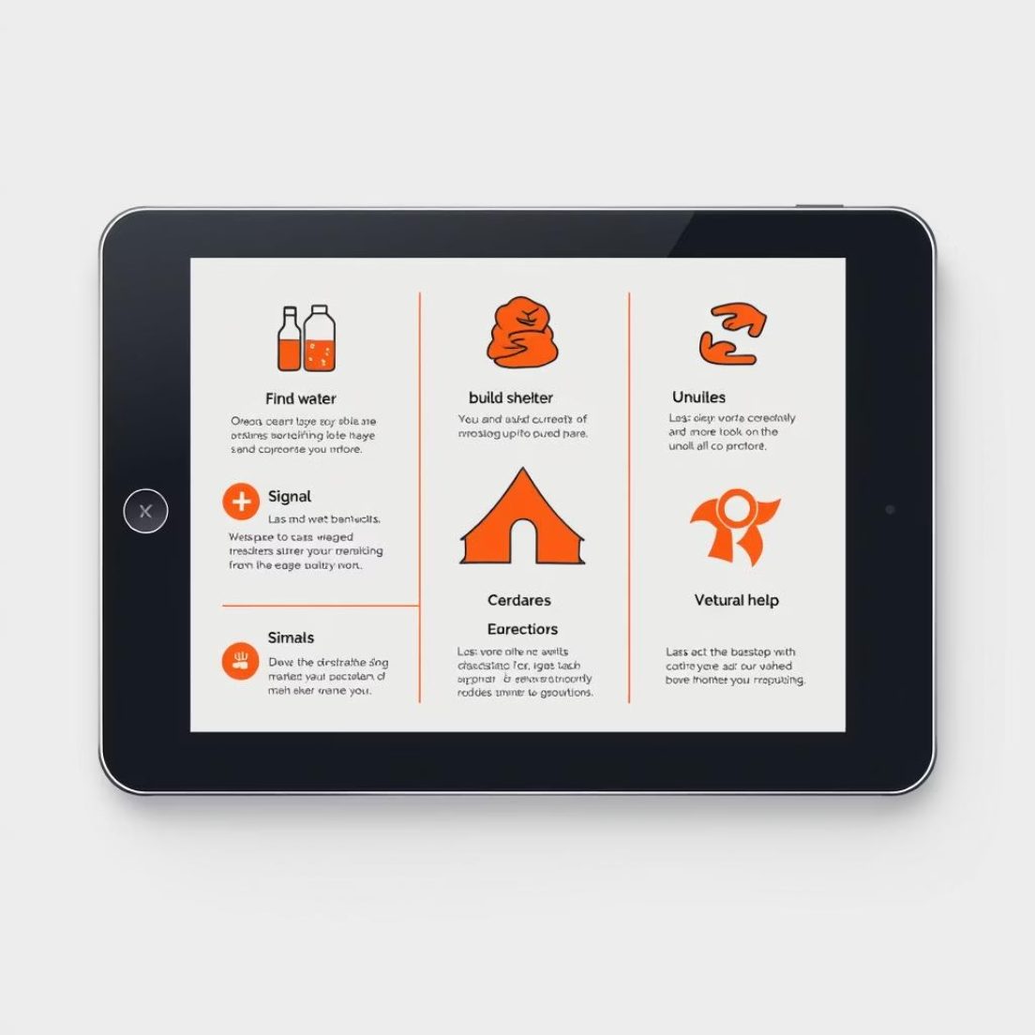
Our Core Features: VaultKit
Safety Map: Live Safe Zones
First-Aid Kit Guide
Survival Tips Infographic
Identify and navigate to nearest safe locations during crises, updated in real-time by community and authorities.
Interactive guide on assembling and using a comprehensive first-aid kit, with step-by-step instructions for basic medical emergencies.
Visual, easy-to-understand infographics covering critical survival skills for diverse situations, from natural disasters to urban emergencies.

Slide 4
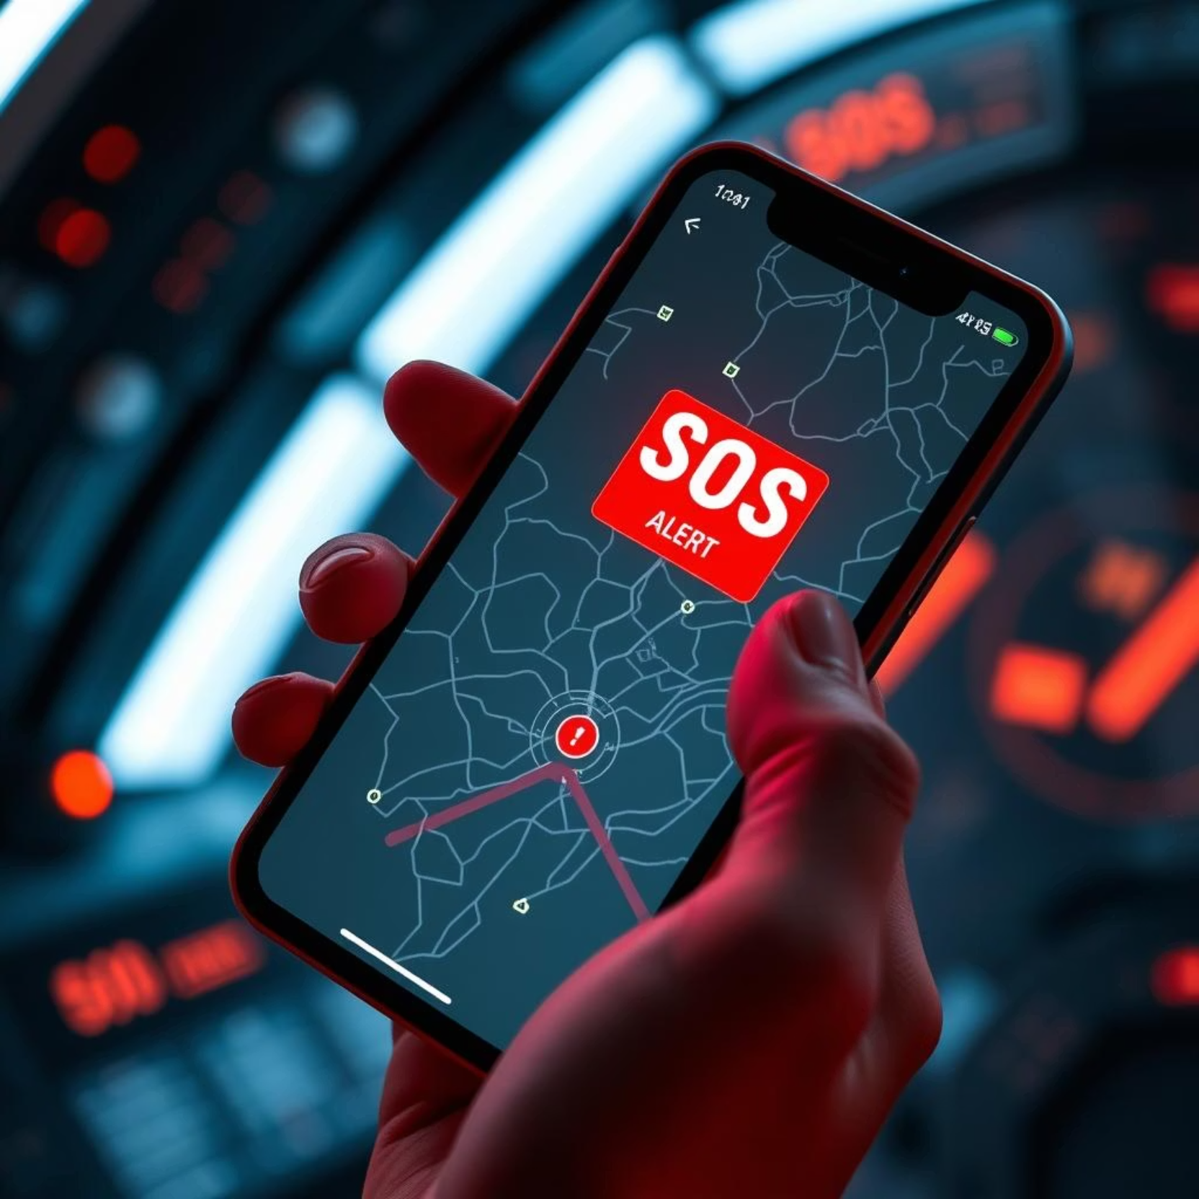
EchoAlert: Instant Emergency Response
Panic Button System
A discreet, one-tap solution for immediate distress signaling to pre-selected contacts and emergency services.
Instant Notifications & Emergency Access
Quickly sends vital information like location and medical details to first responders, ensuring rapid and informed assistance.

Slide 5
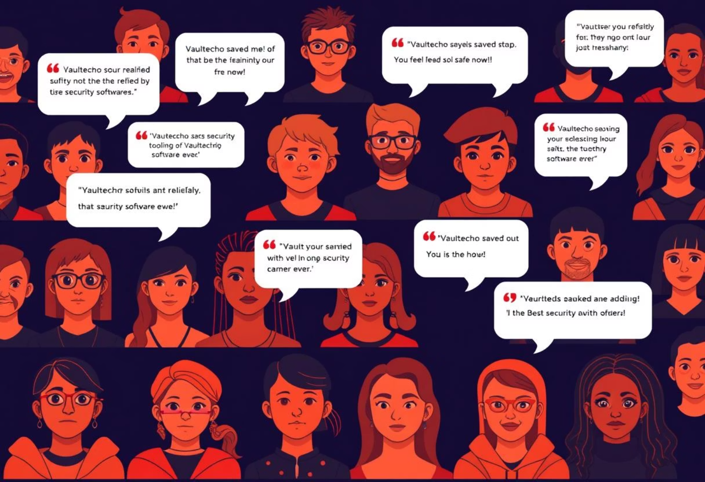
Community Power: United in Safety
1
Story Board: Real User Experiences
Hear compelling stories from individuals who found help and hope through Vaultecho, building a tapestry of resilience.

Slide 6



Why Vaultecho Stands Out
Static & Private Environment
Inclusive Design
Latest News & Updates
Unlike chat apps, Vaultecho maintains privacy by offering a non-conversational, secure platform for critical information.
Tailored for everyone — men, women, kids, and elders — ensuring universal accessibility and ease of use.
Stay updated with real-time safety alerts, community updates, and new survival tips. We bring you the latest information to help you stay informed and prepared.

Slide 7
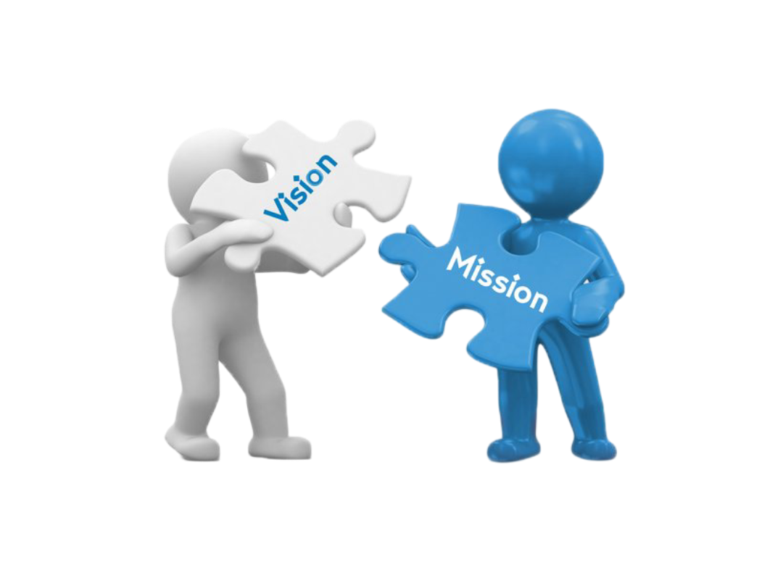
About Us: Our Misson & Vision
Our Team
Our Values
Our Purpose
Born from deep thought and strong purpose, Vaultecho was founded by Pariwash Khan and Ammar Ahmed Khan , a vision shaped by care, courage, and the belief that safety is a right, not a privilege.
Security, accessibility, and community resilience are at the core of everything we build.
We want to teach the youth about safety and spread awareness because staying safe is a right for everyone.

Slide 8
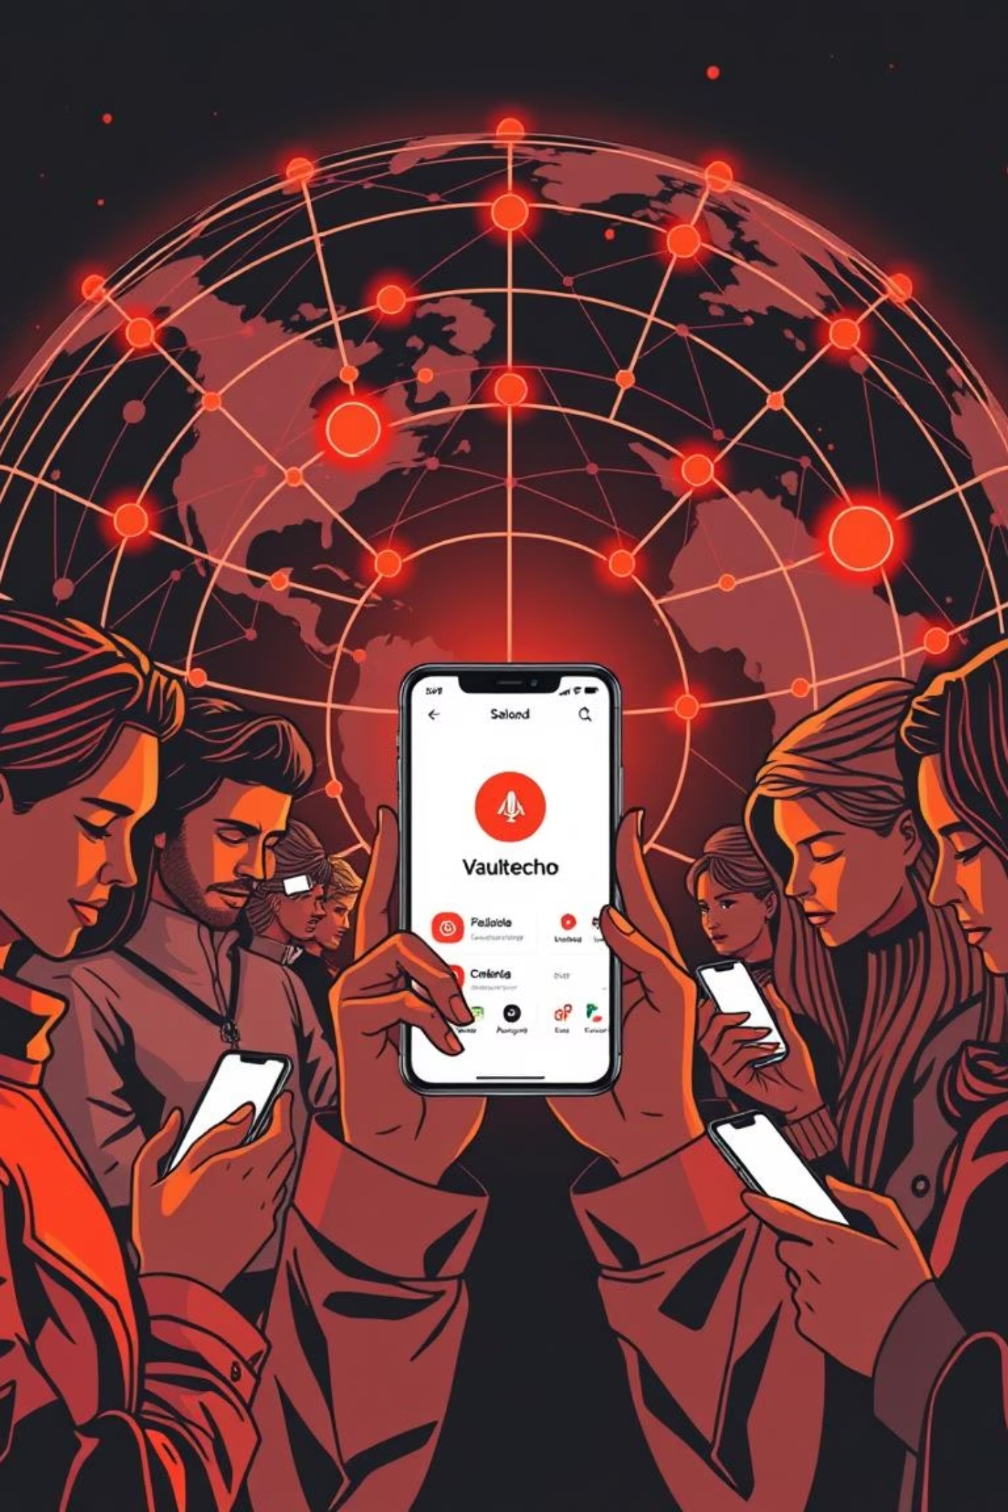

Thank You!
We truly appreciate your time and attention. Vaultecho is more than just an idea, it’s a mission to make safety accessible, trusted,
and empowering for everyone.
Stay tuned as we build a digital space that protects, informs, and connects.
Together, let’s echo safety — loud, clear, and everywhere.

